Slide 1
Venue Booking Portal
USER MANUAL :
LHC Room Booking

Slide 2
Contents
Important Guidelines
Login Page
As a Faculty Member
Book a New Slot
Old LHC (LHC-1)
New LHC (LHC -2)
Dashboard – LHC Booking (Faculty Only)
Calendar
Room and Time Slots
Booking Details
Confirm Booking
Bookings Display

Slide 3
Important Guidelines
The User (Student/Faculty) must login with his/her Channel i credentials only.
2) An individual user can only book upto 2 time slots per day.

Slide 4
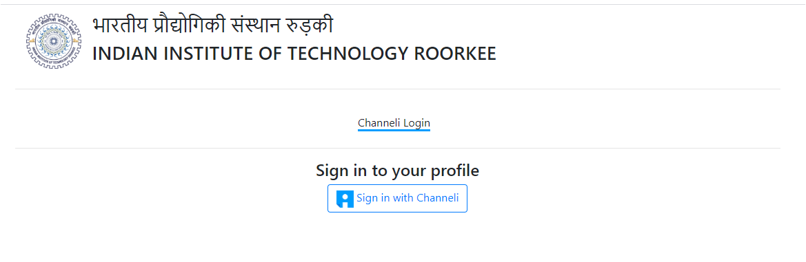
Login Page
CLICK HERE !

Slide 5
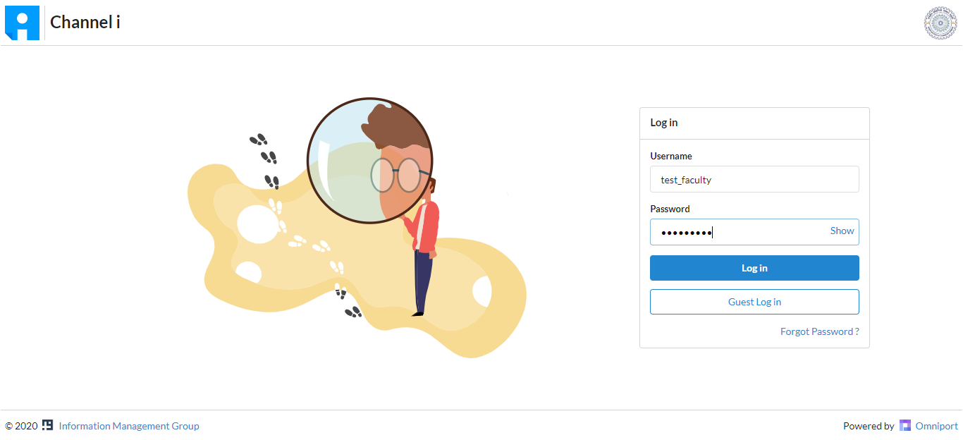
Login Page
Login using your Channel i credentials

Slide 6
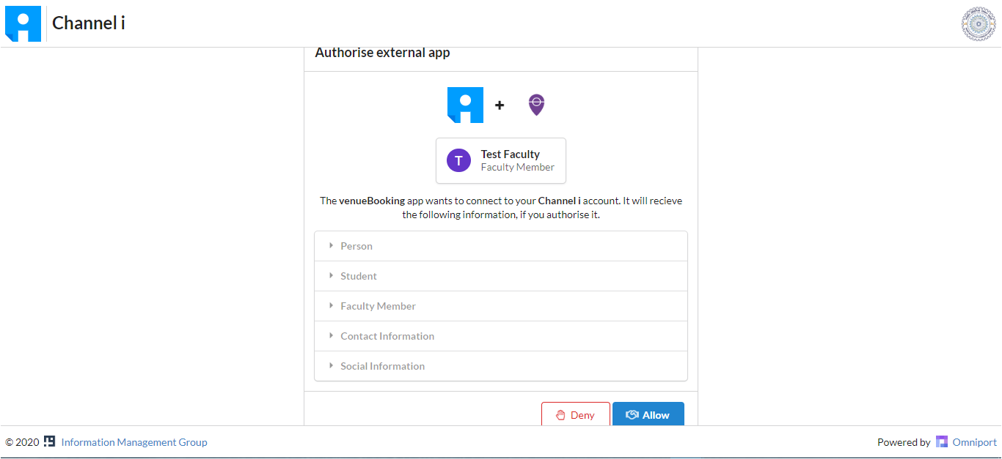
Login as a Faculty Member
Click on Allow

Slide 7
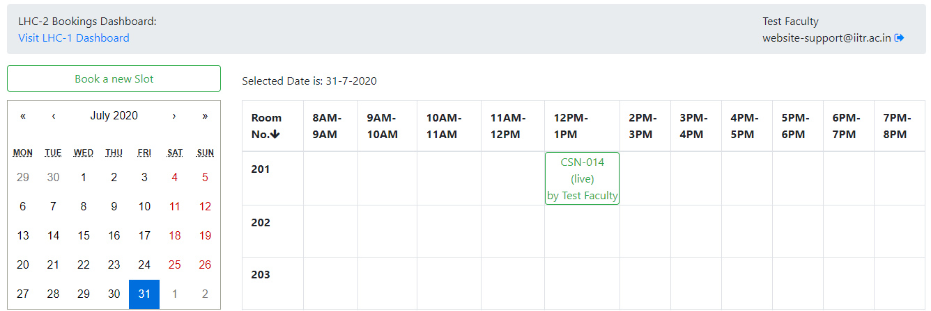
Book a new Slot
To switch between LHC-1/LHC-2 depending upon which one to book
Click on this to Logout
Click on Book a new Slot for a new LHC room booking
This region displays all the LHC-1/LHC-2 bookings as per the date selected

Slide 8
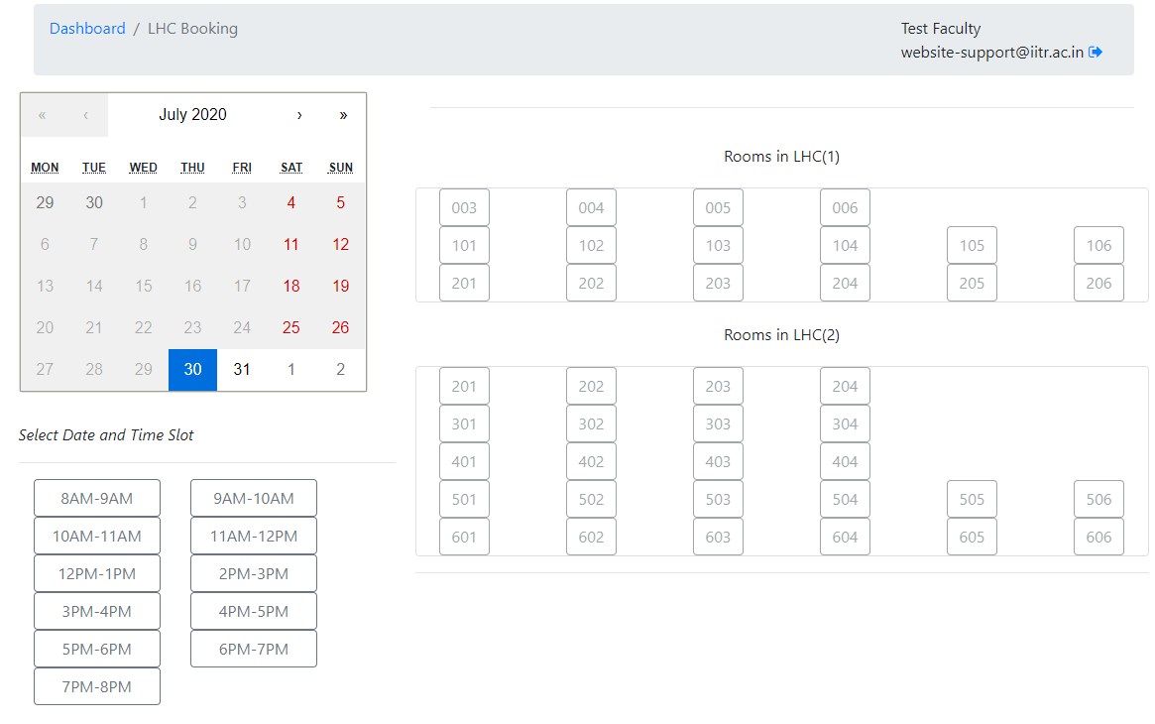
Booking Portal: LHC

Slide 9
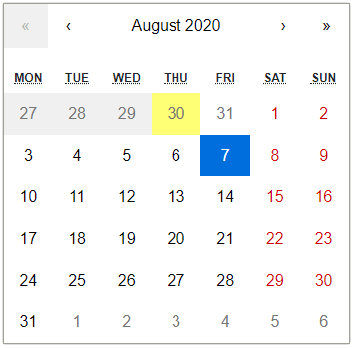
Calendar
To change the Month selected
To change the Year selected
Yellow colour highlights today’s date
Grey region indicates those days that are either fully booked or the date has expired
Blue colour highlights date selected for booking
Red colour highlights usual holidays/weekends

Slide 10
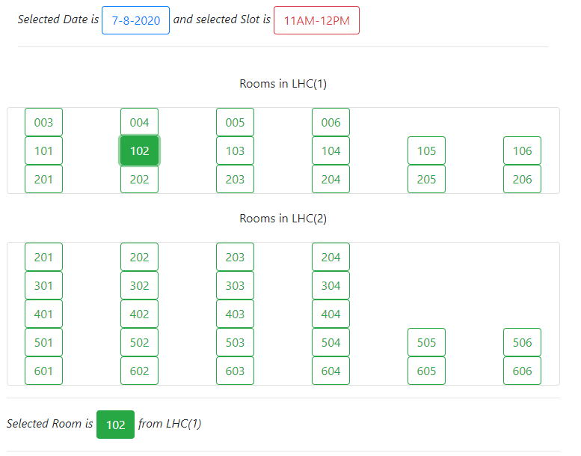
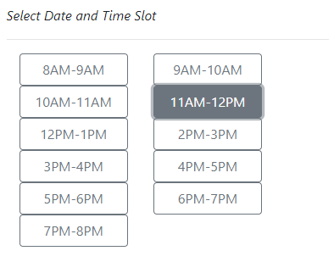
Rooms and Time Slots
Select any room no. from any of the two LHC Buildings
Select any time slot

Slide 11
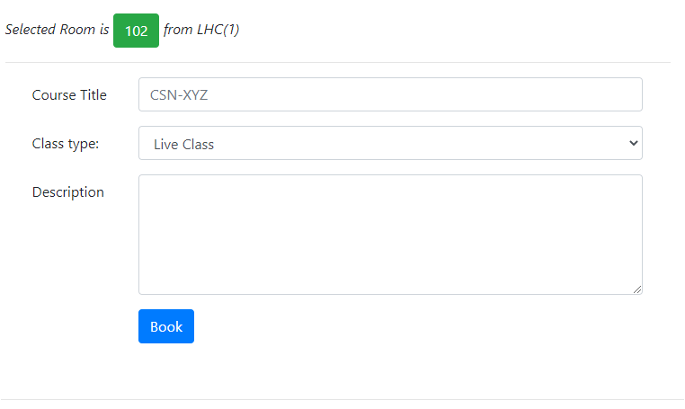
Booking Details
Enter the course title of the class to be held
Select between Live Class and Recording depending upon the type of class
Enter the details about the class (Optional)
Click on the Book button to confirm booking

Slide 12
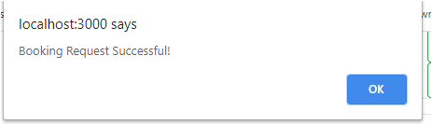
Confirm Booking
After clicking on the Book button a prompt appears confirming the booking. Click on OK to confirm

Slide 13
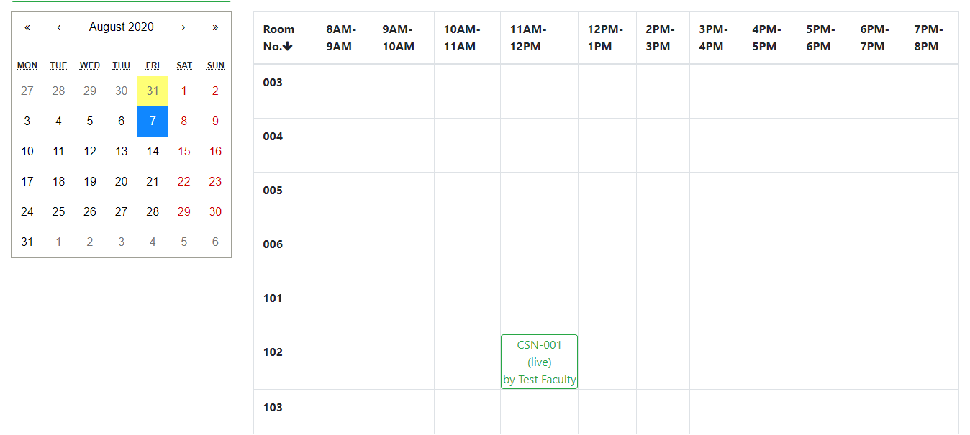
Bookings Display
The approved bookings will be displayed in the calendar dashboard as shown below.

Slide 14
THANK YOU

